Slide 1
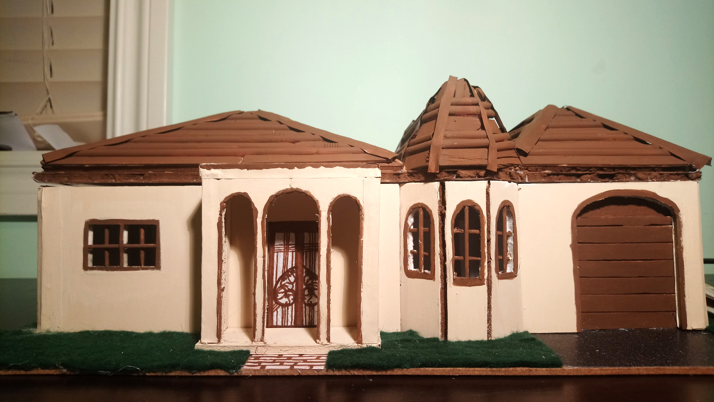
Mediterranean Style Home
Insert Picture
JHANVI AND AIYESHA

Slide 2
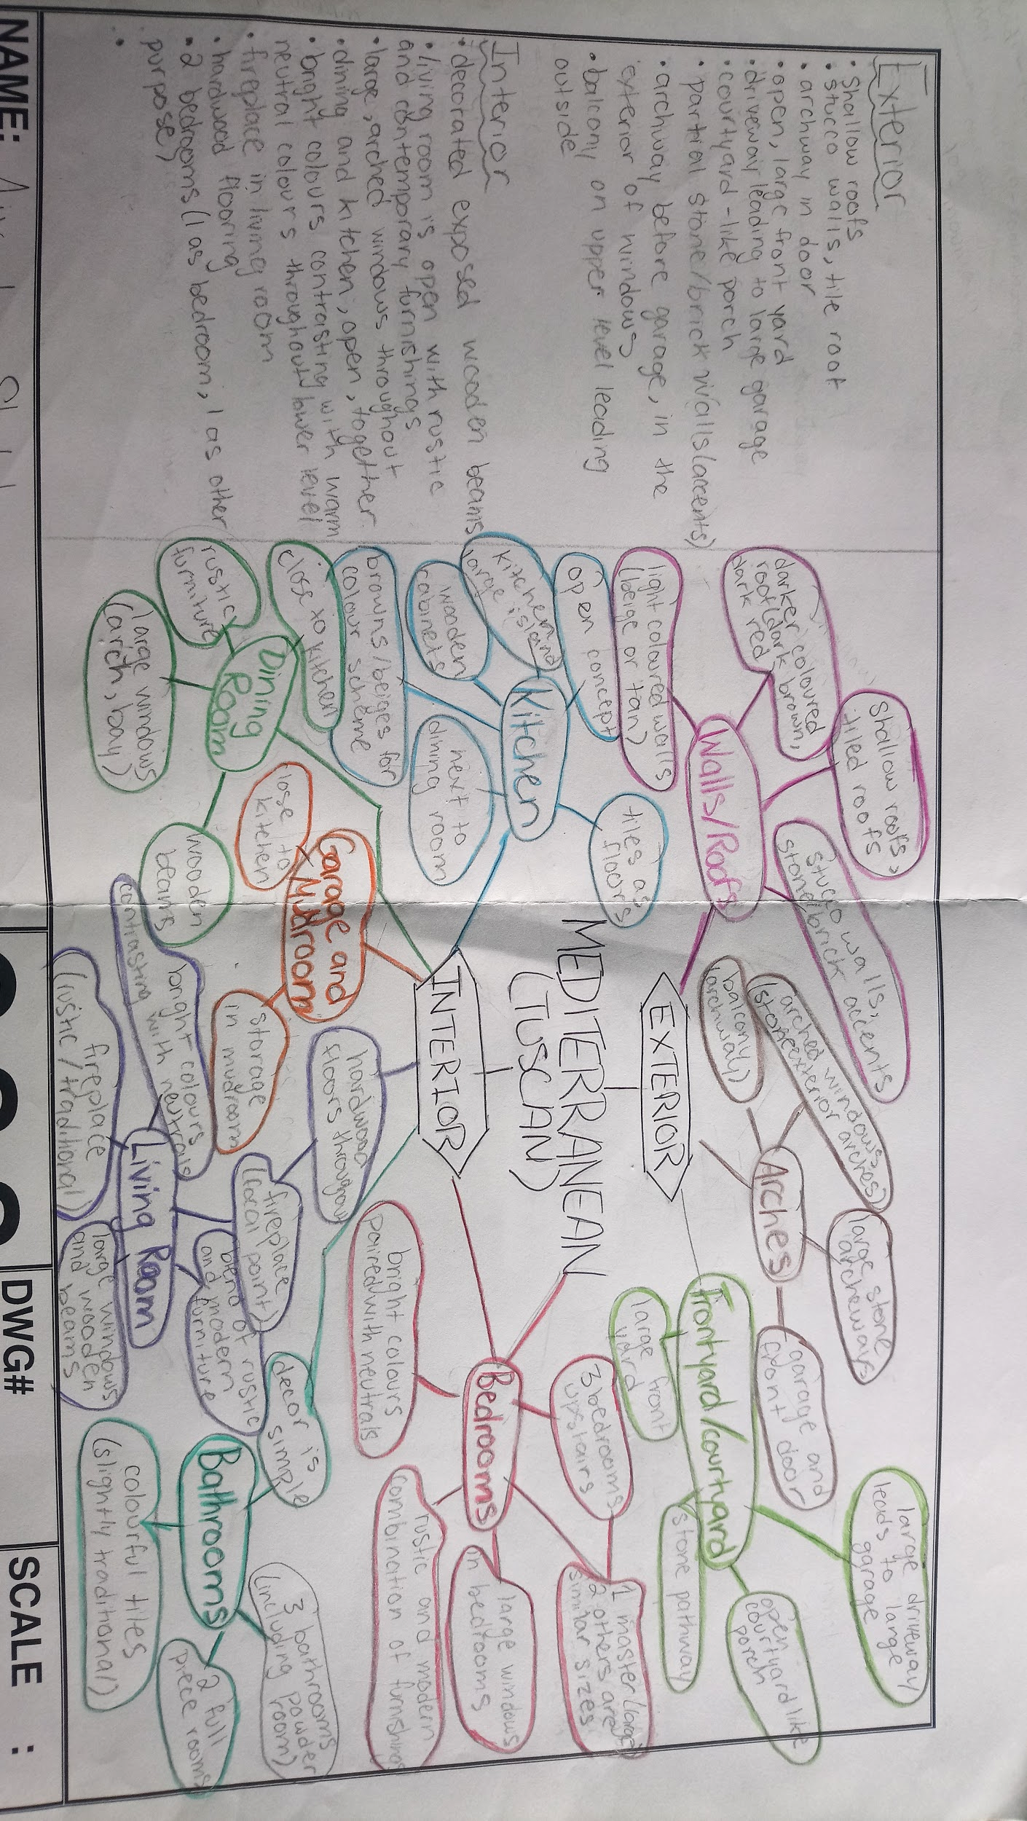
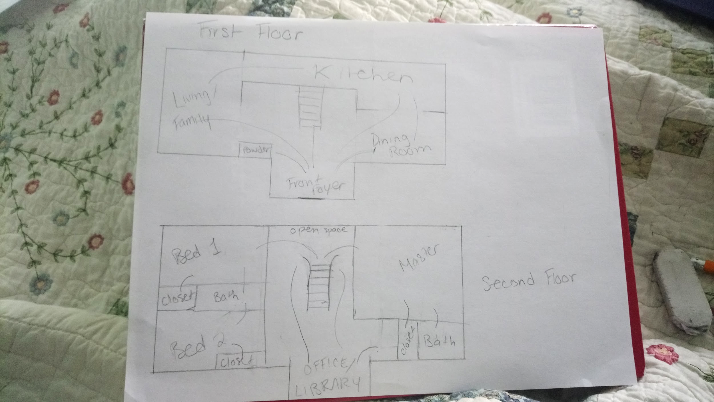
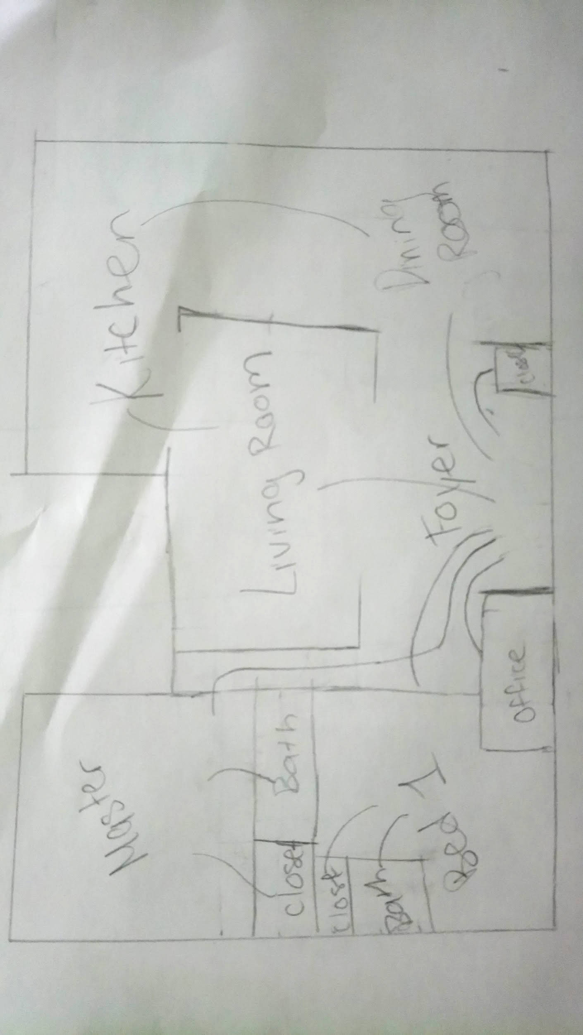
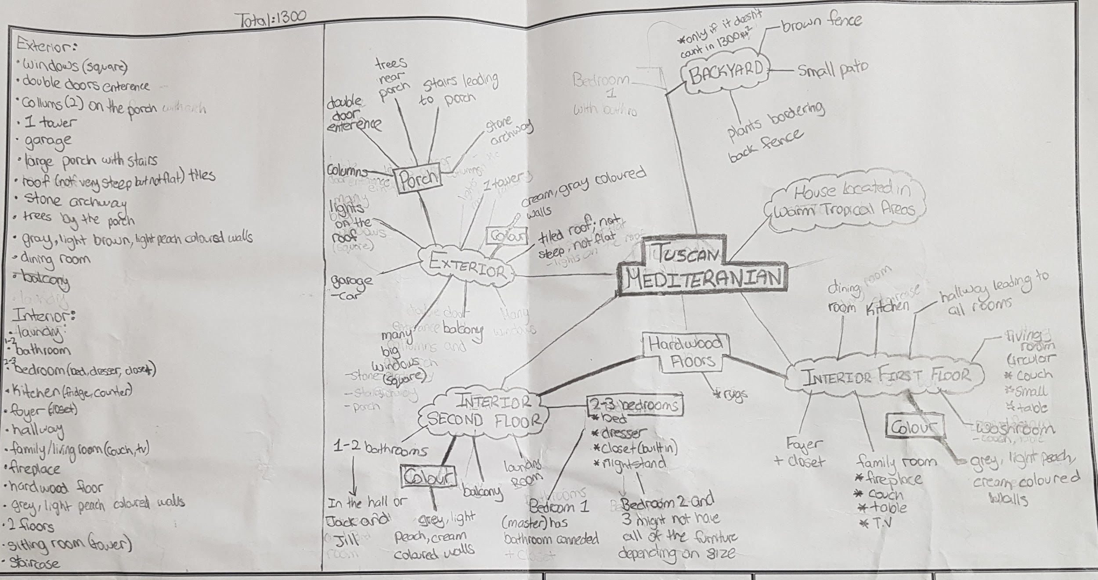
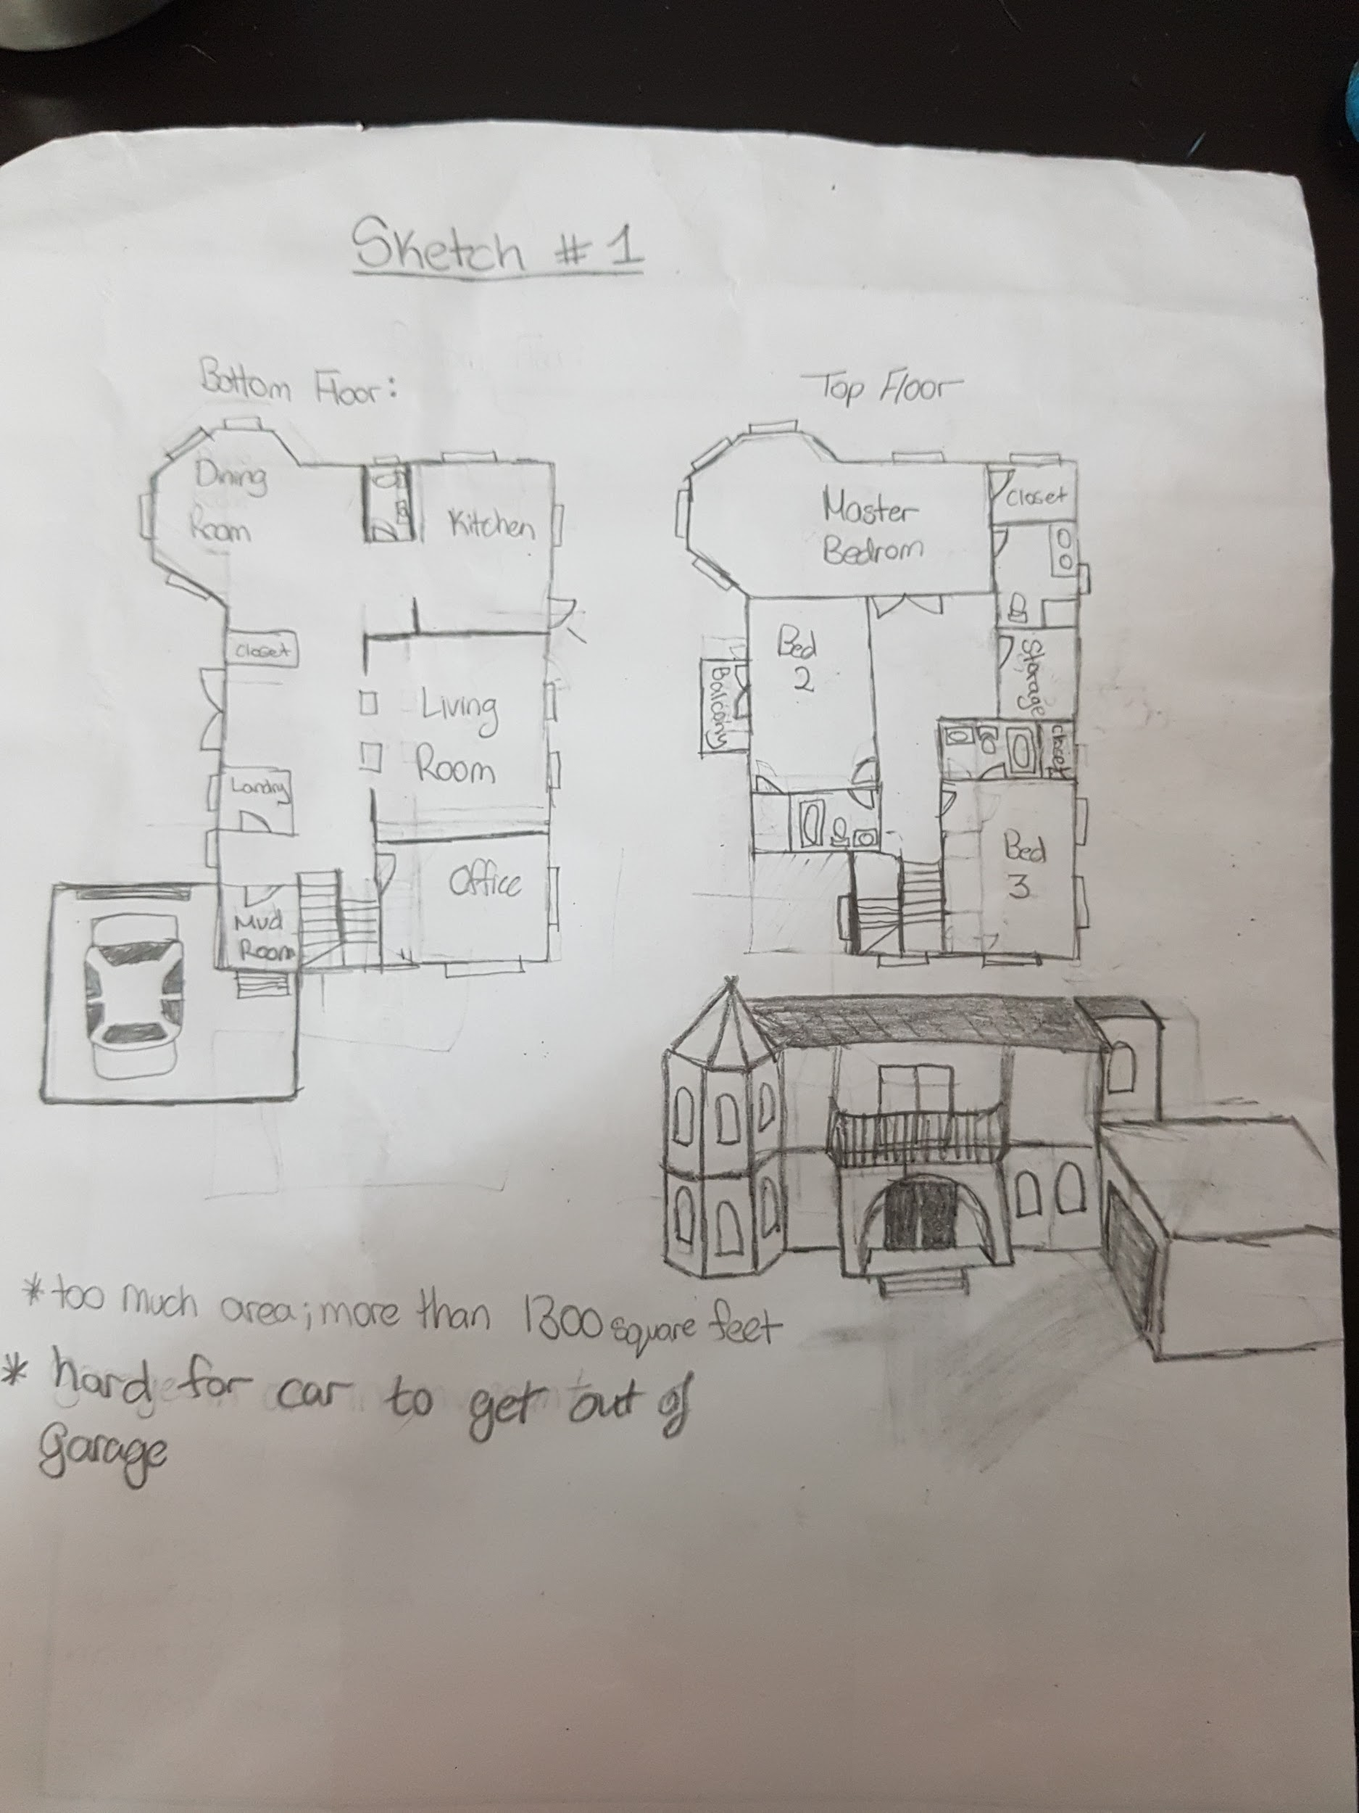
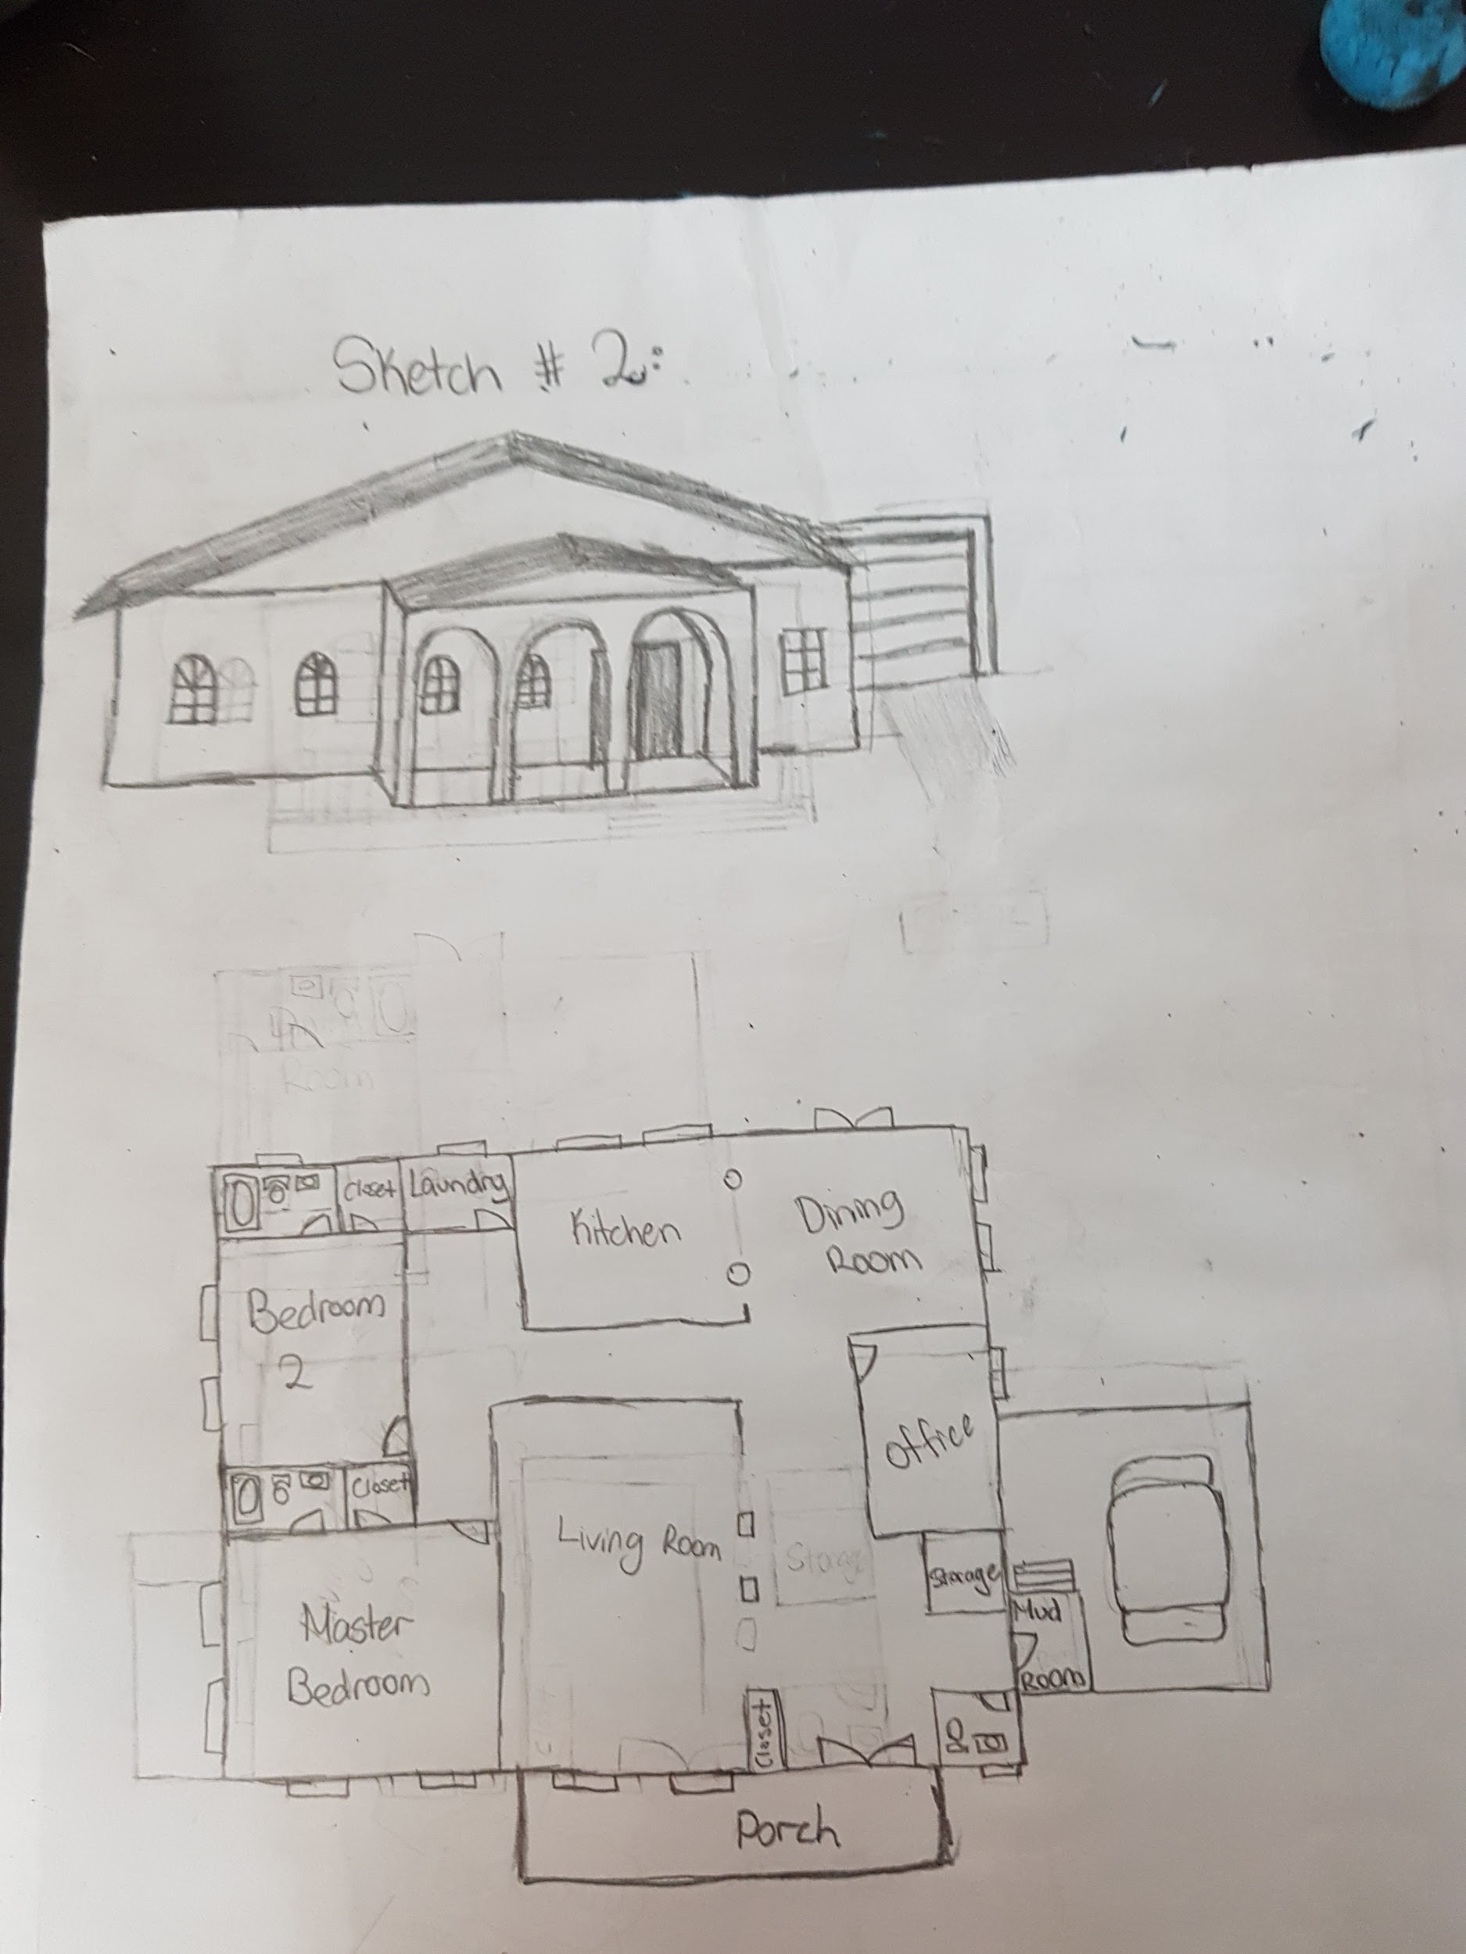
Bubble Diagrams/Sketches

Slide 3
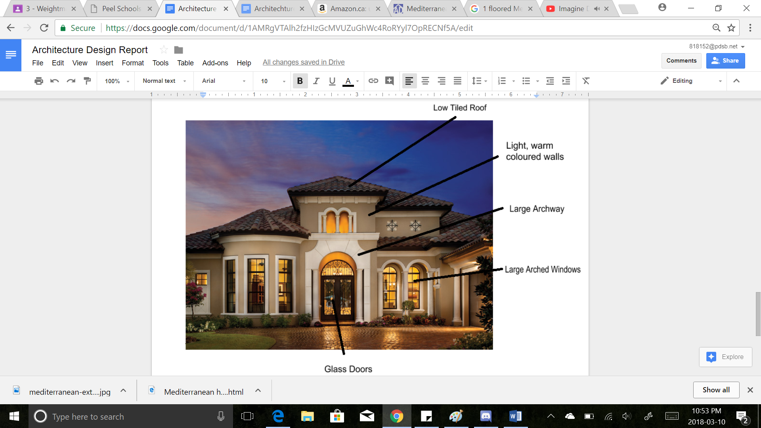
Mediterranean House
Situation
To design and build a house according to the client needs; a couple in hopes of moving to a warm climate region
In need of a large living and dining room, to host guests

Slide 4
Problems
Constraints:
space and materials; we had limited square footage (1300 square feet), and a base of 12’’ by 16’’ to build the house on
time; we had a deadline to complete sketches, floor plan, 3D rendering, and the 3D model
scaling; we had to come up with a way to make our model fit on the 12” by 16” base, to have space for exteriors, and not have a model that is too small
Size of the rooms had to follow the Building Code of Architecture
Problems faced while constructing:
Some measurements had to be recalculated due to the thickness of walls
Laser cutter was occupied so some parts had to be hand cut
Coming up with a scale

Slide 5
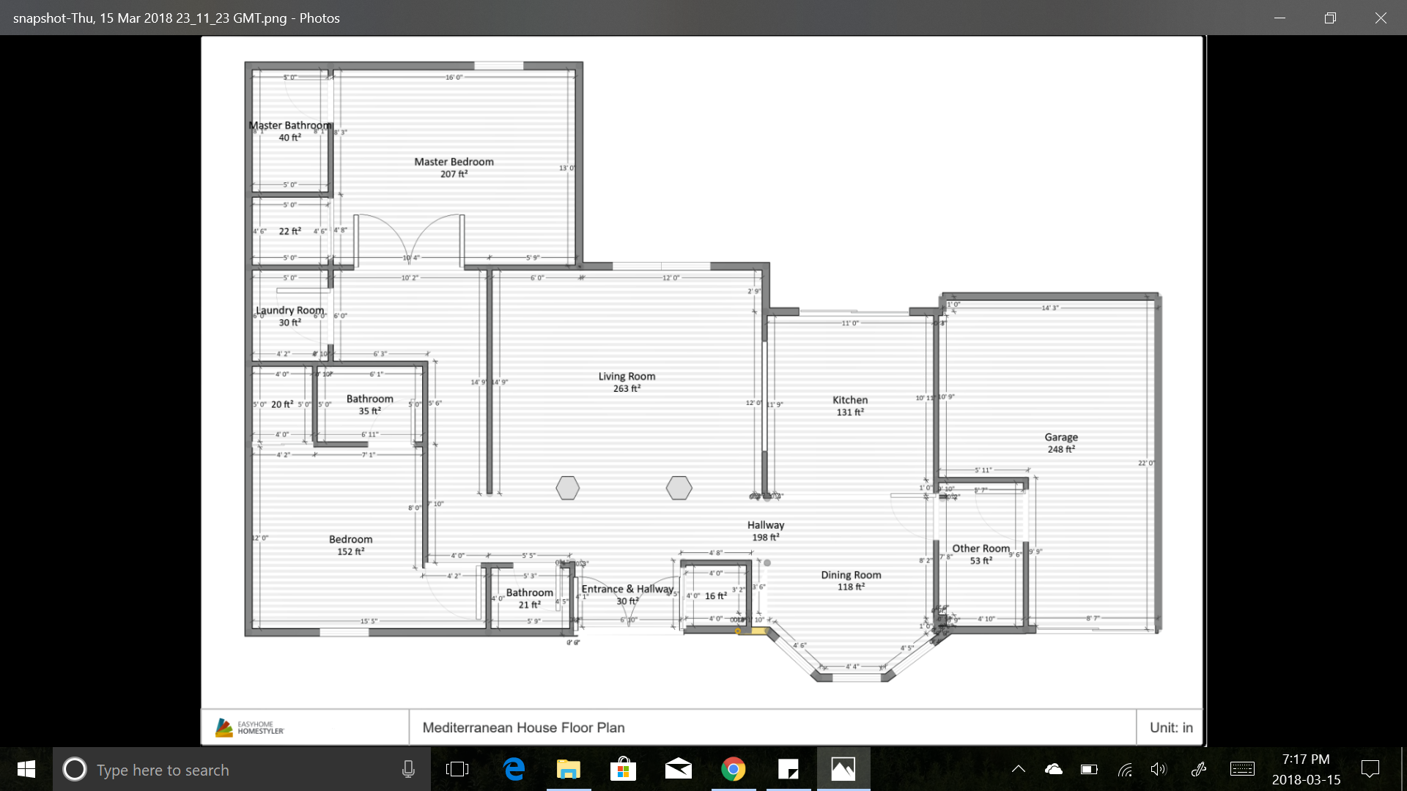
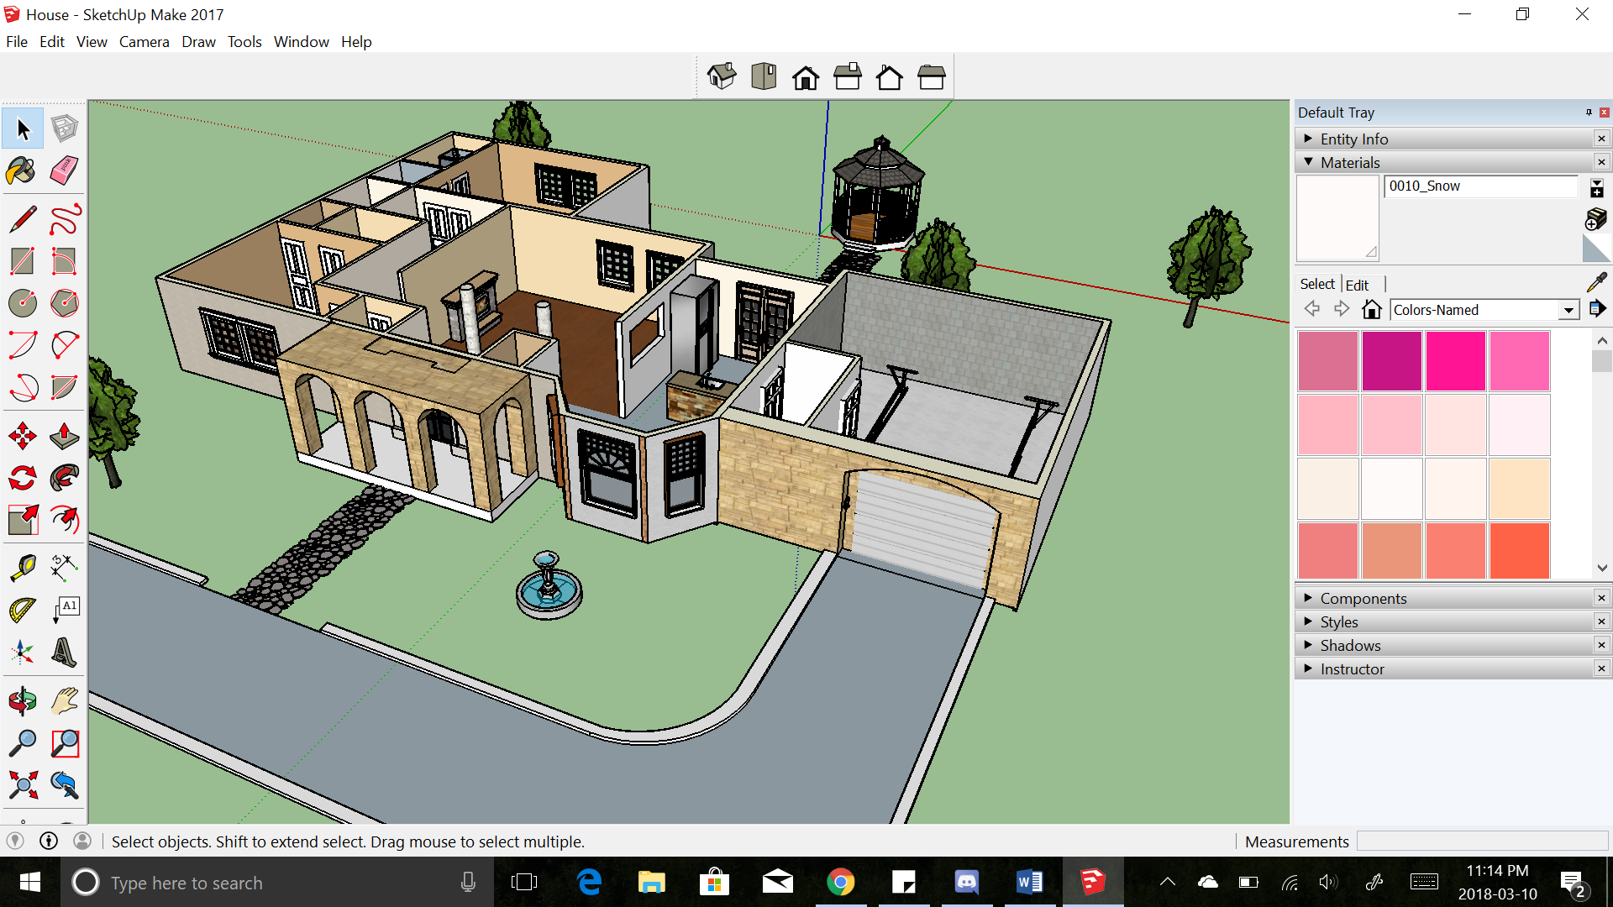
Before Construction
Floor Plan
3D Rendering

Slide 6
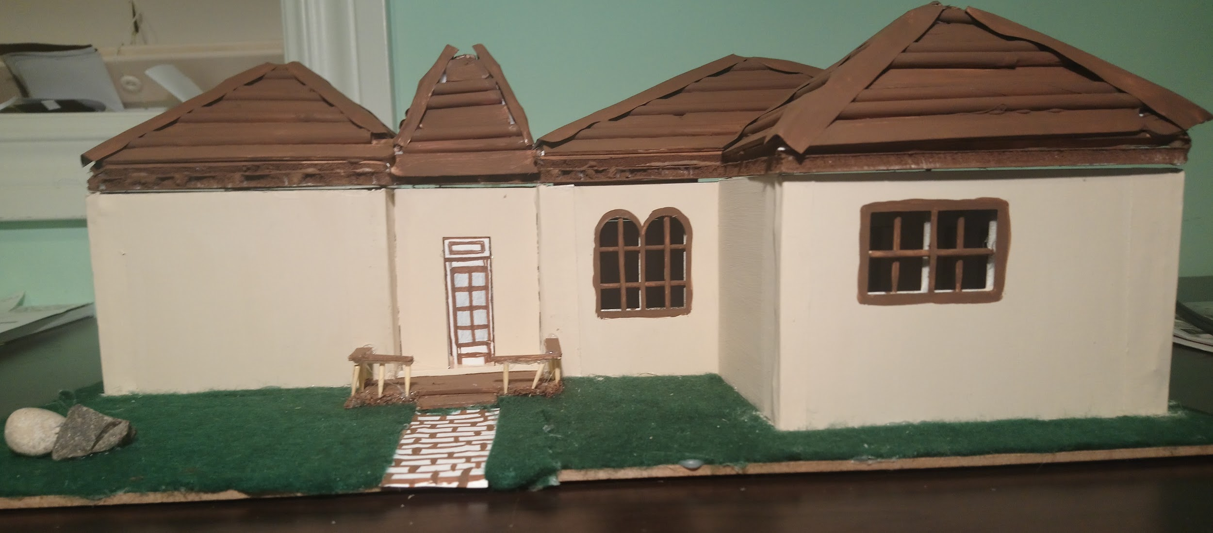
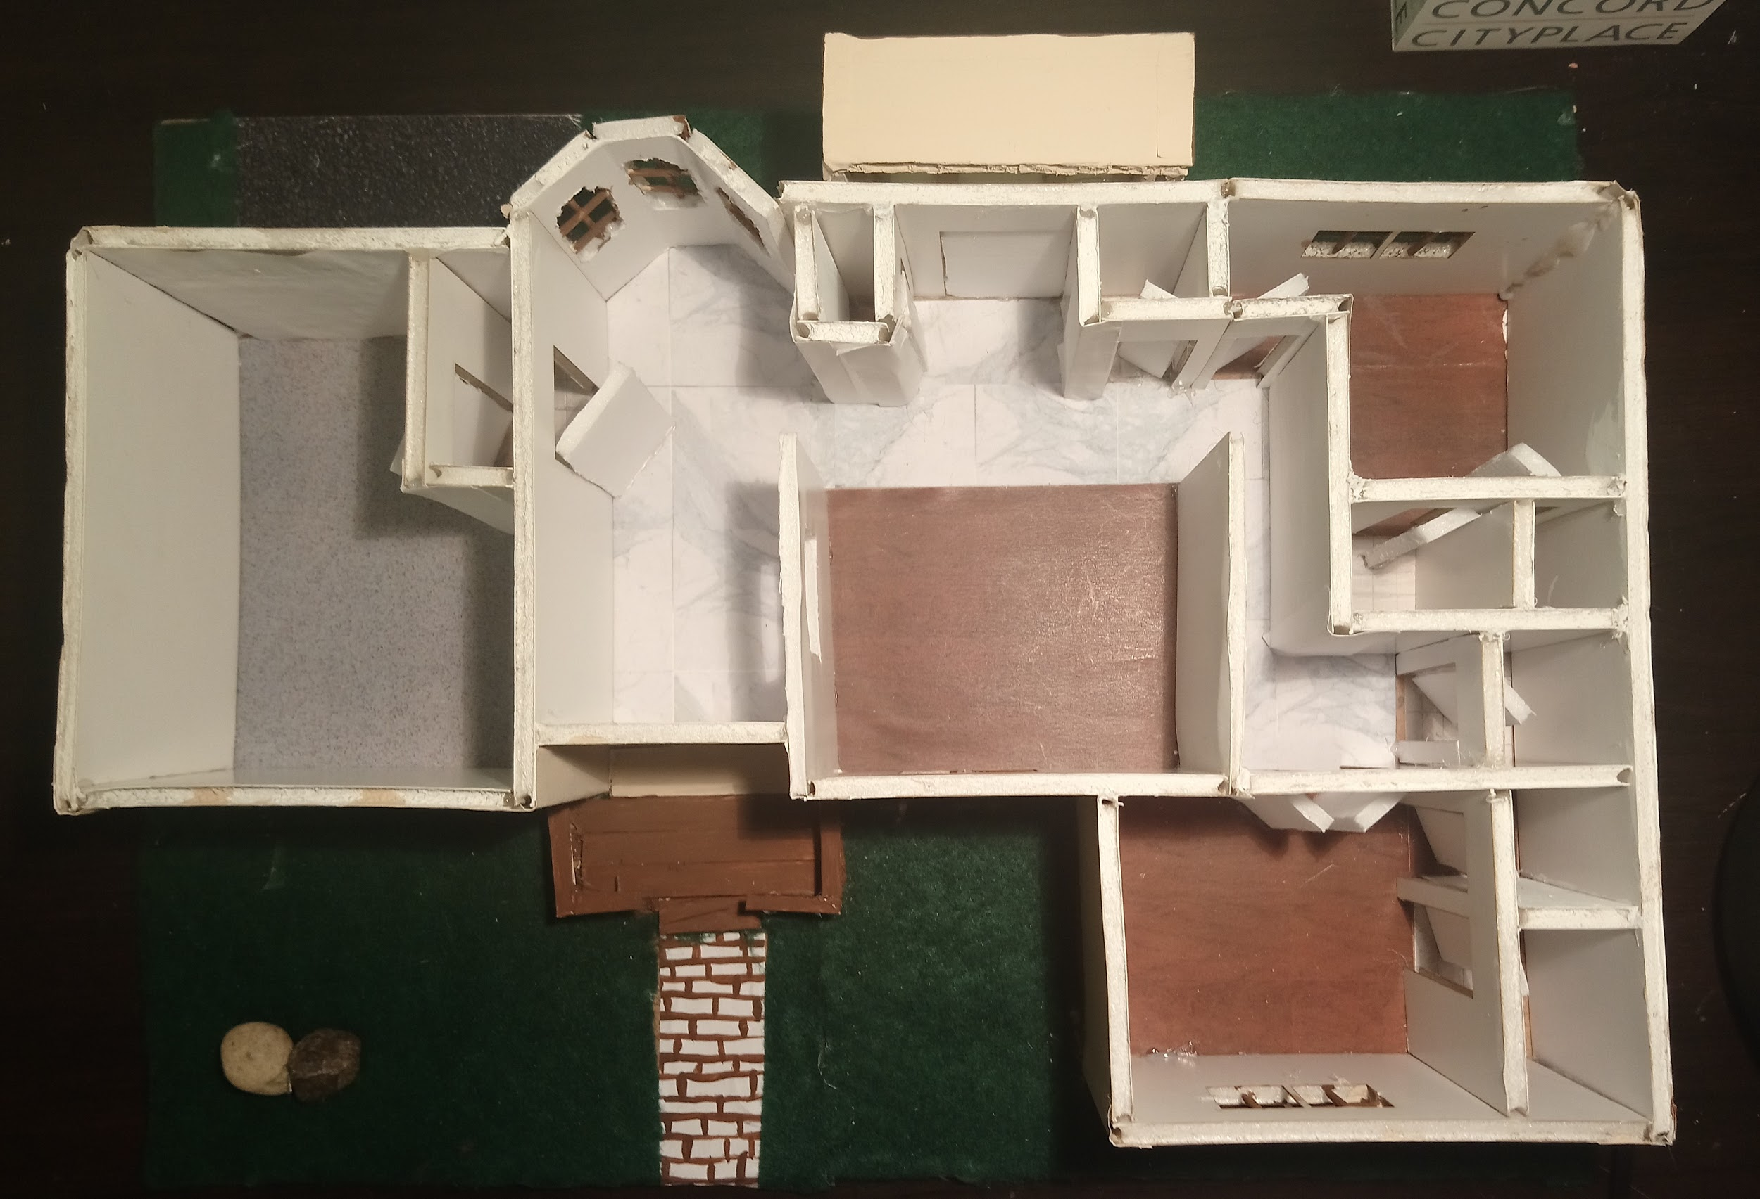
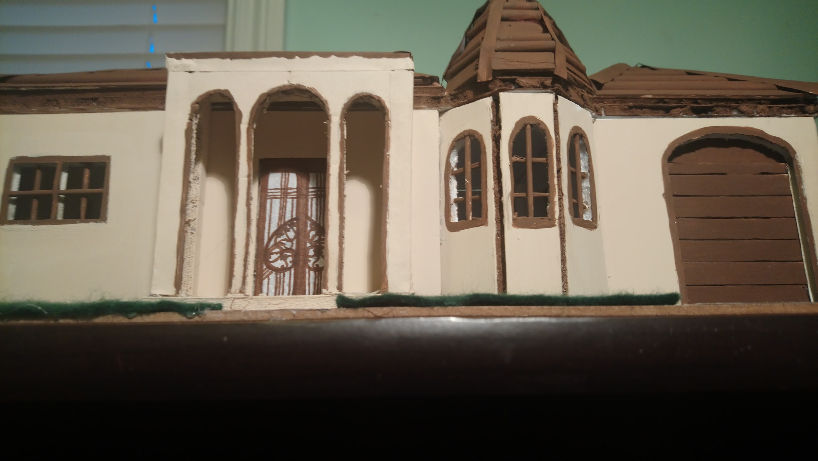
Construction
We used foam board, popsicle sticks, straws, green felt, and toothpicks to make our model
Different types of floorings were used for different rooms inside
Arches were used for the front exterior of the house. Arched windows were used for most windows.

Slide 7
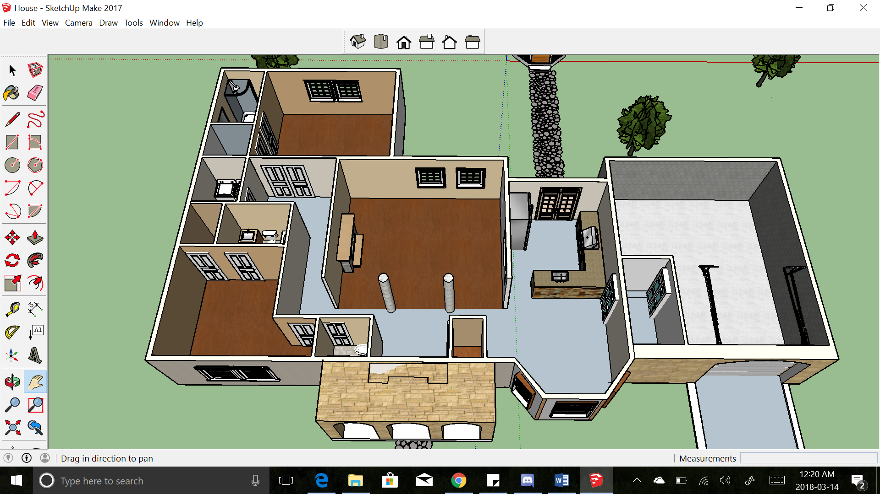
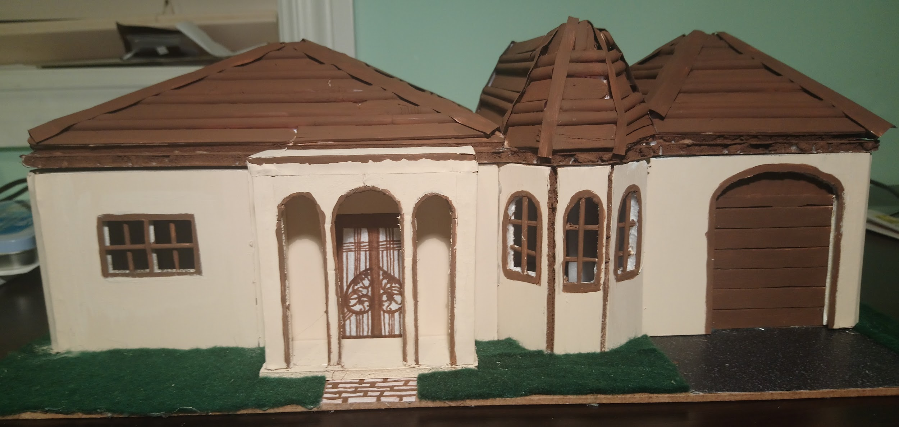
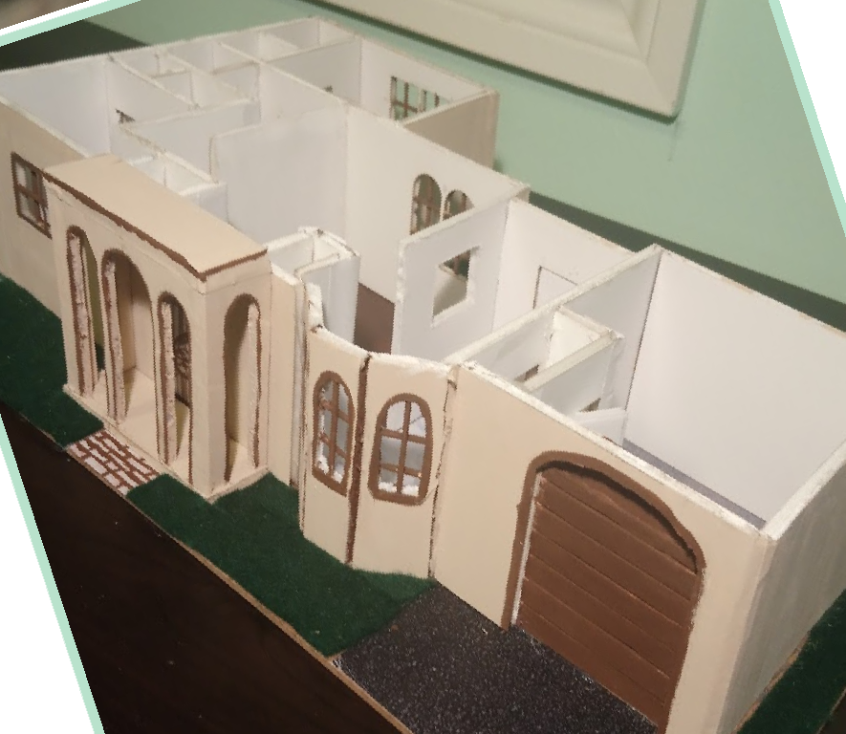
Evaluation
Overall, the house is about 1303.5 sq feet
Living Area:
Living /family Room
Dining
Other:
1 Garage, mudroom, Driveway
Powder room
Closet
Hallway connecting all rooms
Sleeping Area:
2 bedroom
2 bathroom
2 Closets
Service Area:
Kitchen
Laundry

Slide 8
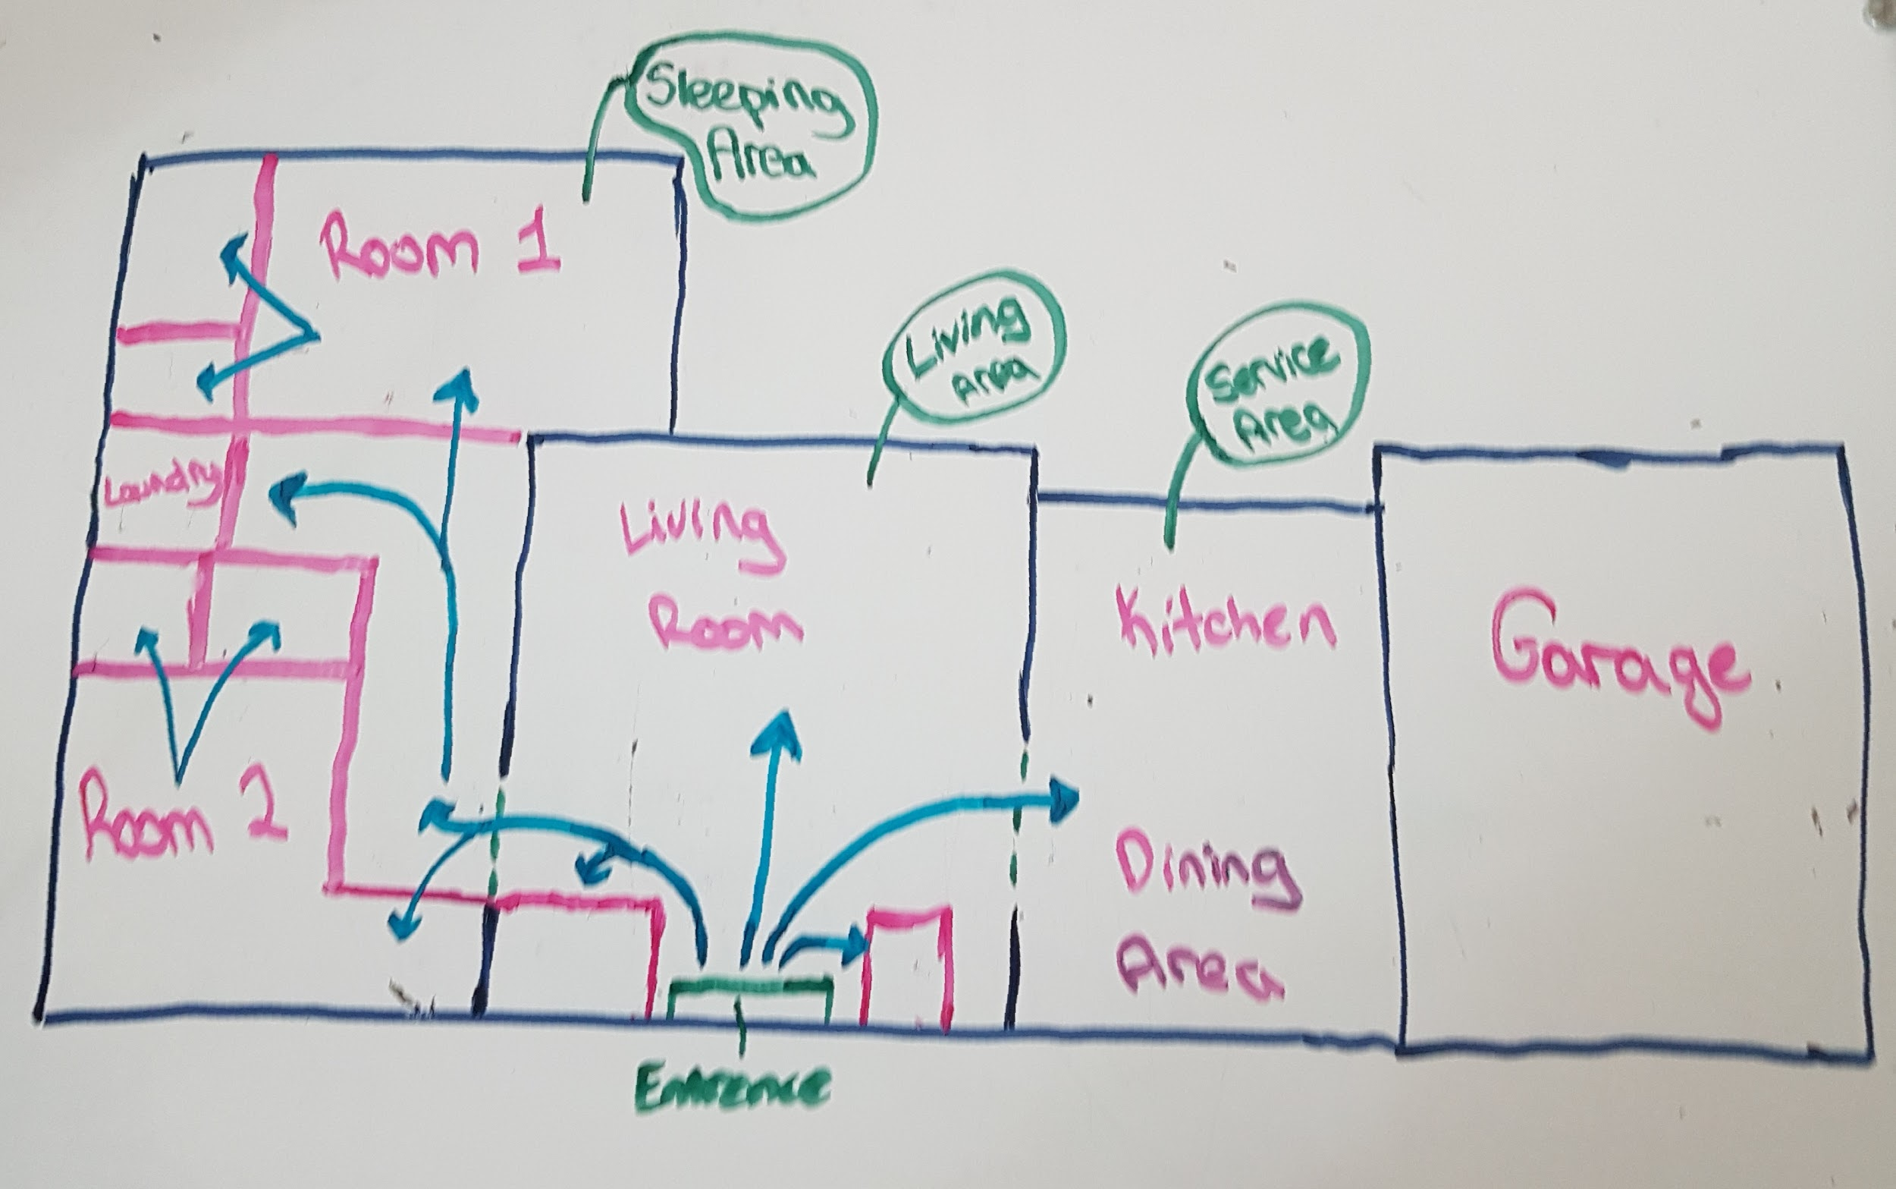
The House: Living Area
Includes the foyer, living/family room, a powder room, dining room, porch, deck, and storage closets
The living room is made bigger than the minimum, has hardwood flooring throughout.
The powder room has tile flooring and is located near the front foyer and is easy to access for anyone who needs to use it.
The entrance leads guests straight to the living area
The dining room is near the living room which means that guests can relax in the living room right after dinner.
The dining room, foyer and the hallway connecting it all, would have marble flooring
The deck is wooden (made of popsicle sticks), and the porch is large with an archway.

Slide 9
The House: Service Area
The service area includes the kitchen, laundry room, garage.
The laundry room is placed near the bedrooms, it has tile flooring.
The kitchen is easily accessible from the entrance, as well as the dining room.
The kitchen is located near the garage for easy accessibility.
The storage/coat closet has hardwood flooring is located by the front door.
The kitchen also uses marble flooring.

Slide 10
The House: Sleeping Area
The sleeping area is relatively separate from the other sections of the house, it is located in the far left side of our house
There are 2 bedrooms, each with their own bathroom and closet
The sleeping area is located separately in the house so it provides privacy
The bedrooms are open rooms and each have windows. They have
hardwood flooring.
The bathrooms have tile flooring.

Slide 11
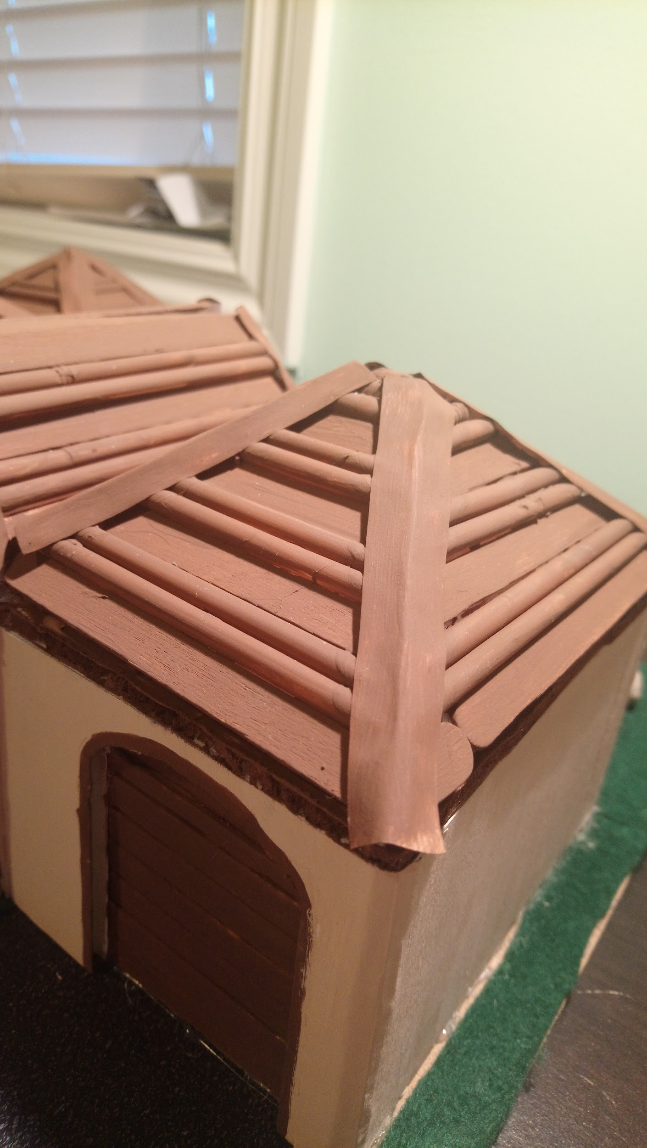
The House: Exterior
The colour scheme of the exterior is beige and brown (typical Mediterranean colours)
The roof is shallow, and made of popsicle sticks and straws. In reality it would be made with brown tiles.
Arches are located in the front doorway and garage
The backyard is large, with a wooden deck (made of popsicle sticks)
Stone pathways lead to the front door, and
the back door
Large driveway leads to the garage.

Slide 12
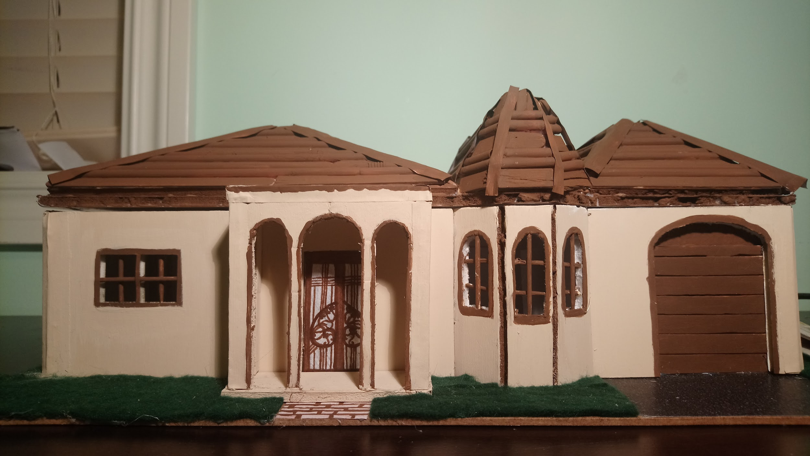
Thanks for Listening!

